Slide 1
PIP2001 PROFESSIONAL PRACTICE-II VIVA-VOCE
PATIENT CASE SIMILARITIES
(Skin Smart APP)
Batch Number: CEI 08
Name |  | Roll Number
Yarragudi Akshath Kumar Reddy | - | 20211CEI0152
UdayKiran Perisetty | - | 20211CEI0153
Pasala Jaswanth | - | 20211CEI0121
Pasaluru Abhinay Kumar | - | 20211CEI0137
Under the Supervision of,
Dr. Sudha P
Associate Professor
School of Computer Science and Engineering
Presidency University
Name of the Program: Computer Engineering (AI&ML)
Name of the HoD: Dr. Gopal Krishna Shyam
Name of the Program Project Coordinator: Dr. Sudha P
Name of the School Project Coordinators: Dr. Sampath A K / Dr. Abdul Khadar A / Mr. Md Ziaur Rahman

Slide 2
Introduction
In recent years, advancements in mobile technology and artificial intelligence have significantly transformed the healthcare industry. The development of mobile applications for health management has enabled individuals to access healthcare services more efficiently and conveniently. One such critical area of health that can benefit from technological innovation is dermatology. Skin diseases affect millions of people worldwide, necessitating a reliable, accessible, and efficient method for detection and management. This project aims to address this need by developing a comprehensive mobile application for skin disease detection and management, utilizing the Android platform with Kotlin for backend functionality and Android XML for frontend design. The application is designed to cater to three primary user roles: Admin, Hospitals, and Users. Each role is equipped with distinct capabilities to enhance the overall functionality and user experience of the system. Admins are provided with a secure login interface and functionalities to add and manage hospital details and view registered users.

Slide 3
Introduction…
Users, the core beneficiaries of the application, can log in to access features aimed at improving skin health management. For users, the application offers advanced image recognition technology to scan and detect skin diseases. This feature empowers users with the ability to perform initial diagnostics from the comfort of their homes. Additionally, users can view nearby hospitals, add appointments with dermatologists, and maintain a history of their medical consultations and treatments. This comprehensive suite of features ensures that users receive continuous and integrated care for their skin health. The integration of advanced image recognition technology for disease detection, coupled with functionalities for appointment management and medical history maintenance, positions this application as a revolutionary tool in dermatology care. The use of Kotlin for backend processes ensures robust performance, while Android XML provides a flexible and intuitive user interface. Overall, this mobile application aims to bridge the gap between patients and healthcare providers, offering a seamless and integrated experience for managing skin health, from initial diagnosis to ongoing care.

Slide 4
Literature Review
Year | Author/Link | Title | Outcomes
2023 | Abuzaghleh, O., Barkana, B. D., & Faezipour, M. | Mobile-based skin lesion detection using deep learning and smart feature selection | Developed a mobile application for skin lesion detection leveraging deep learning and smart feature selection, achieving high accuracy and efficiency.
2022 | Mishra, R., & Ghorai, S. | Skin lesion detection using machine learning: a systematic review | Conducted a comprehensive review of machine learning techniques for skin lesion detection, highlighting the strengths and limitations of various approaches.
2022 | Nguyen, Q. T., & Nguyen, B. P. | AI-based mobile application for skin cancer detection using image processing techniques | Developed an AI-based mobile application for skin cancer detection, utilizing image processing techniques to improve diagnostic accuracy and user accessibility.

Slide 5
Year | Author/Link | Title | Outcomes
2021 | Moleanu, I., Diaconu, R., & Marcu, L | Mobile application for skin cancer detection using artificial intelligence | Created a mobile application employing artificial intelligence for skin cancer detection, demonstrating potential for early diagnosis and wide accessibility.
2021 | Gupta, A., Tomar, D., & Gautam, A. | Skin disease detection using convolutional neural network | Implemented a convolutional neural network for skin disease detection, achieving high classification accuracy and demonstrating the potential for clinical use.

Slide 6
Research Gaps Identified
Current systems for skin disease management typically involve manual processes, where patients must visit dermatologists for diagnosis and treatment. There is limited use of technology for early detection and management, leading to delayed treatments. Appointment scheduling and patient history tracking are often inefficient, relying on paper records or basic digital systems. Additionally, finding nearby specialized hospitals can be cumbersome, lacking integration and user-friendly interfaces for comprehensive care.

Slide 7
DISADVANTAGES
Reliance on manual diagnosis and treatment scheduling leads to delays and inefficiencies in patient care.
Lack of centralized digital records makes tracking patient history and managing appointments cumbersome.
Difficulty in finding nearby specialized hospitals and lack of integrated, user-friendly interfaces hinder timely and effective treatment.

Slide 8
PROPOSED METHOD
The proposed system is a mobile application designed for comprehensive skin disease management. Built with Android XML for the frontend and Kotlin for the backend, it caters to three user roles: Admin, Hospitals, and Users. Admins can log in, add hospitals, and view users. Hospitals can log in to view patient appointments. Users can log in to scan for skin diseases using image recognition technology, view nearby hospitals, schedule appointments, and maintain a history of their consultations. This system aims to streamline skin disease detection and treatment, providing an integrated and user-friendly platform for all stakeholders. Here we are using the Mobile net algorithm. These model is used for the image processing to detected the image.

Slide 9
ADVANTAGES
Android XML ensures an intuitive and accessible frontend for all users.
Users can easily find nearby hospitals, schedule appointments, and maintain a detailed history of their treatments.
Kotlin backend provides robust performance and smooth integration of features, ensuring a reliable application experience.

Slide 10
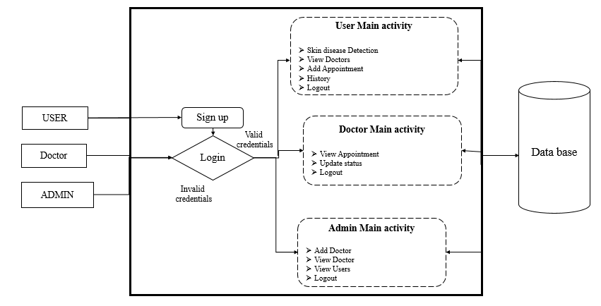
PROJECT FLLOW
Figure: work Flow of Proposed system

Slide 11
HARDWARE & SOFTWARE REQUIREMENTS
SOFTWARE REQUIREMENS
Operating System - Windows 10
JDK - java(koltin)
SDK - Android
IDE -Android studio
Database` - my SQL

Slide 12
HARDWARE & SOFTWARE REQUIREMENTS
HARDWARE REQUIREMENTS
Processor - I3/Intel Processor
RAM - 8 GB
Hard Disk - 1TB

Slide 13
Objectives
Input Design is the process of converting a user-oriented description of the input into a computer-based system. This design is important to avoid errors in the data input process and show the correct direction to the management for getting correct information from the computerized system.
It is achieved by creating user-friendly screens for the data entry to handle large volume of data. The goal of designing input is to make data entry easier and to be free from errors. The data entry screen is designed in such a way that all the data manipulates can be performed. It also provides record viewing facilities.
When the data is entered it will check for its validity. Data can be entered with the help of screens. Appropriate messages are provided as when needed so that the user will not be in maize of instant. Thus, the objective of input design is to create an input layout that is easy to follow.

Slide 14
System Design & Implementation
Modules
USERS: Users can register, login, scan skin diseases using image recognition, view nearby hospitals, add appointments, and maintain a medical history all through a user-friendly mobile application.
ADMIN: Admins can securely login, add new hospitals to the system, and view registered users' details using the mobile application interface.
HOSPITAL: Hospitals can log in securely and access their dedicated interface to view scheduled appointments made by users through the mobile application.

Slide 15
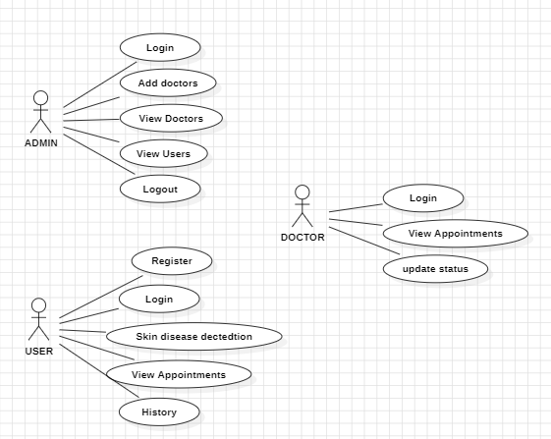
Figure: Use Case Diagram

Slide 16
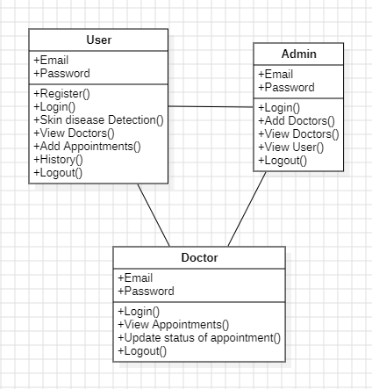
Figure: Class diagram

Slide 17
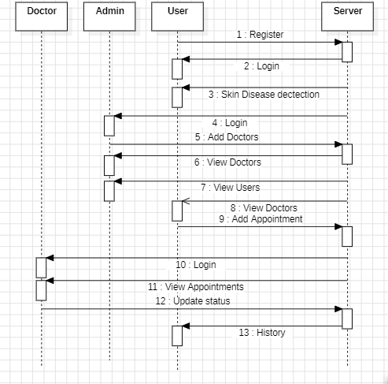
Figure: Sequence diagram

Slide 18
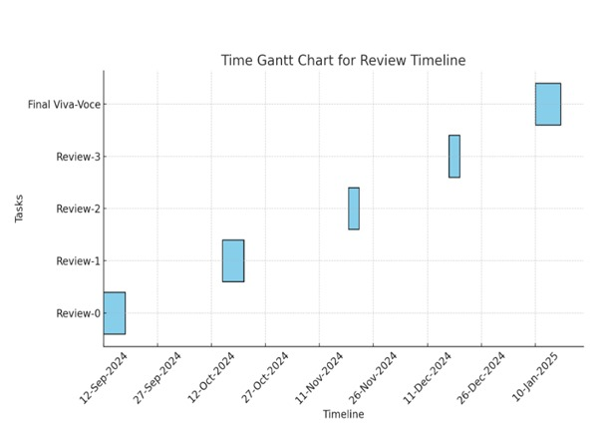
Timeline of Project

Slide 19
Outcomes and Results
In this outcome it reduces the barriers of geography through reliable detection of skin diseases and information about nearby hospitals. Its image recognition allows for early diagnosis and better dermatological care. The appointment and record management will be streamlined in hospitals, thus improving efficiency. Users are empowered to track their medical history, thus fostering proactive health management. Better communication bridges gaps between patients and providers for better care continuity:
Improved Accessibility: The application enables users to attain access to reliable skin disease-detecting tools while easily identifying nearby hospitals. Therefore, this feature lowers geographical limits and enables reaching essential healthcare information at just a click of a button, thus extending dermatological services to reach a much wider audience.

Slide 20
Outcomes and Results
Better Care: Advanced image recognition technology is implemented in the application, so it ensures an accurate and reliable detection of skin diseases. This causes an early diagnosis and, accordingly, a timely medical intervention, so that significantly improves the quality of dermatological care and reduces the risk of complications.
Streamlined Management: This application will allow the hospitals to work effectively on the patients' appointments, registrations, and medical records. This cuts down the work at administration and error; also improves in overall efficiency and management of health services.
User Empowerment: It allows the user to monitor actively his skin health by keeping a comprehensive record of their medical history. The feature fosters informed, proactive steps taken by the users in handling healthcare and instills control and a sense of responsibility.

Slide 21
Conclusion
In conclusion, this mobile application represents a significant advancement in the field of dermatology by integrating advanced image recognition technology and comprehensive healthcare management features. By utilizing Kotlin for backend development and Android XML for frontend design, the application ensures robust performance and an intuitive user experience. Admins can efficiently manage hospital details and user registrations, hospitals can streamline patient appointments, and users can access reliable skin disease detection, nearby hospital information, and maintain their medical history. This multi-faceted approach not only enhances the efficiency of dermatological care but also empowers users to take proactive steps in managing their skin health. The seamless integration of these features creates a holistic platform that bridges the gap between patients and healthcare providers, ensuring continuous and comprehensive care. Overall, this application stands as a testament to the potential of mobile technology in revolutionizing healthcare management.

Slide 22
References
Abuzaghleh, O., Barkana, B. D., & Faezipour, M. (2023). Mobile-based skin lesion detection using deep learning and smart feature selection. In 2023 IEEE 20th International Symposium on Biomedical Imaging (ISBI) (pp. 1-4). IEEE.
Mishra, R., & Ghorai, S. (2022). Skin lesion detection using machine learning: a systematic review. Journal of Ambient Intelligence and Humanized Computing, 13(2), 1021-1034.
Nguyen, Q. T., & Nguyen, B. P. (2022). AI-based mobile application for skin cancer detection using image processing techniques. Journal of Medical Imaging and Health Informatics, 12(2), 345-352.
Moleanu, I., Diaconu, R., & Marcu, L. (2021). Mobile application for skin cancer detection using artificial intelligence. In 2021 International Conference on e-Health and Bioengineering (EHB) (pp. 1-4). IEEE.
Gupta, A., Tomar, D., & Gautam, A. (2021). Skin disease detection using convolutional neural network. Procedia Computer Science, 167, 2419-2428.

Slide 23
Han, S. S., Kim, M. S., Lim, W., Park, G. H., Park, I., & Chang, S. E. (2020). Classification of the clinical images for benign and malignant cutaneous tumors using a deep learning algorithm. Journal of Investigative Dermatology, 140(7), 1538-1546.
Tschandl, P., Rinner, C., Apalla, Z., Argenziano, G., Codella, N., Halpern, A., & Kittler, H. (2020). Human–computer collaboration for skin cancer recognition. Nature Medicine, 26(8), 1229-1234.
Liu, Y., Jain, A., Eng, C., Way, D. H., Lee, K., Bui, P., & Coz, D. (2020). A deep learning system for differential diagnosis of skin diseases. Nature Medicine, 26(6), 900-908.
Esteva, A., Kuprel, B., Novoa, R. A., Ko, J., Swetter, S. M., Blau, H. M., & Thrun, S. (2017). Dermatologist-level classification of skin cancer with deep neural networks. Nature, 542(7639), 115-118.
Brinker, T. J., Hekler, A., Enk, A. H., Berking, C., Haferkamp, S., Hauschild, A., ... & von Kalle, C. (2019). Deep neural networks are superior to dermatologists in melanoma image classification. European Journal of Cancer, 119, 11-17.

Slide 24
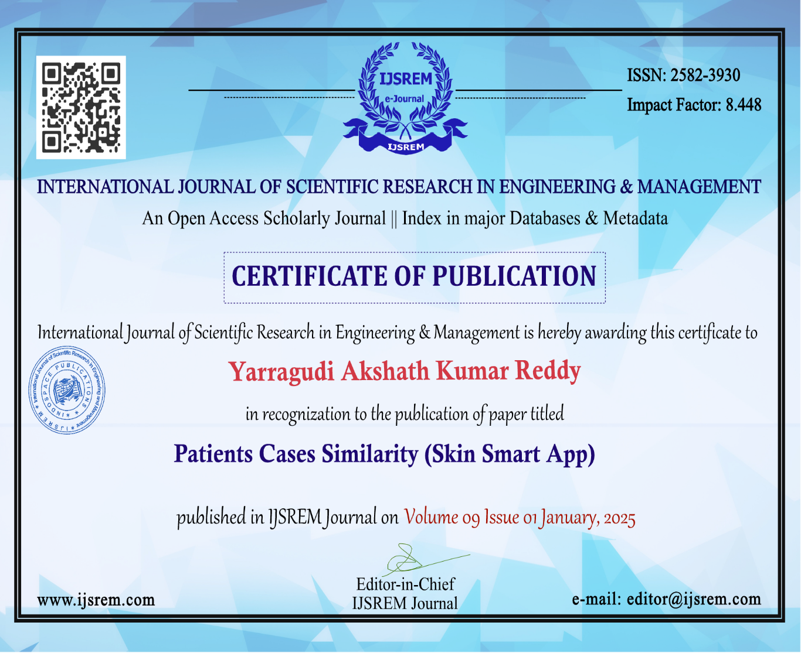
Publication Details

Slide 25
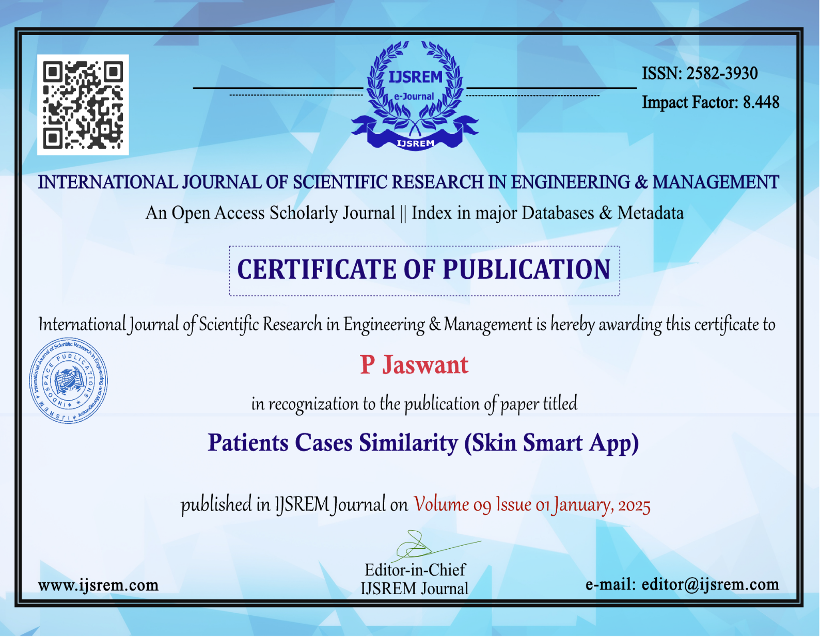

Slide 26
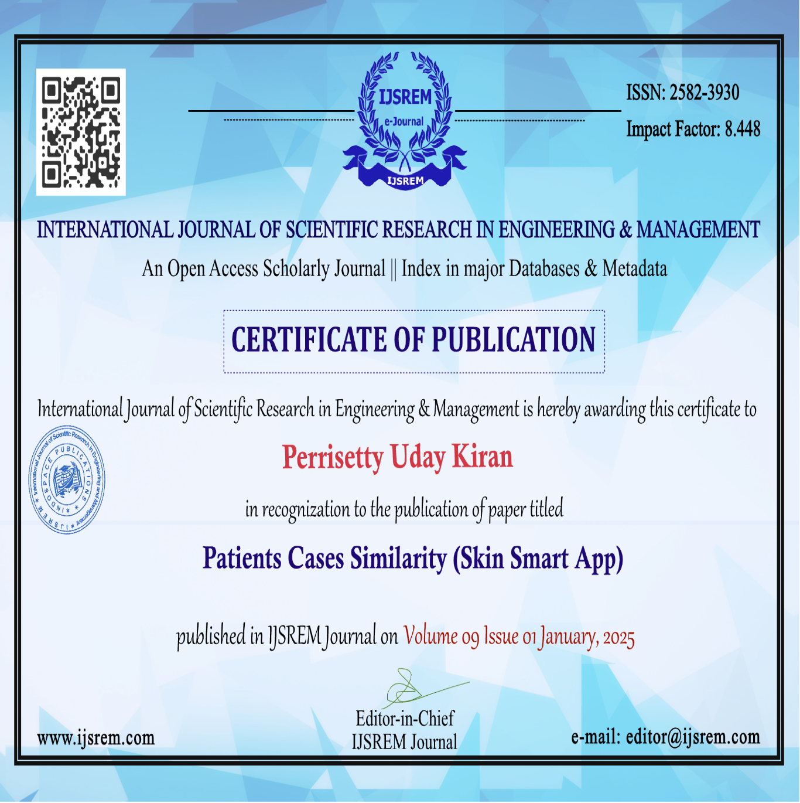

Slide 27


Slide 28

Thank You

